Slide 1
National Board Certification CTE Focus
Growing Accomplished Practice
Impacting Student Learning

Slide 2
Mission of the National Board for Professional Teaching Standards
Maintain High and Rigorous Standards
Certify teachers who meet those Standards
Support efforts for Accomplished Teachers to lead their profession
A process “by teachers, for teachers”
https://www.youtube.com/watch?v=zTvJzKHoGEw
Notes:
25 sets of teaching standards from Art to World Languages, for teachers who teach preschool students to high school students. These are the highest standards in the nation
A teacher earns certification once he/she shows they have met the standards through classroom based evidence and content knowledge evidence.
National Board is committed to Teacher leadership by accomplished teachers.

Slide 3
Why National Board?
Purpose:
Positively impact student learning
Principles:
National Board Standards
Five Core Propositions
Architecture of Accomplished Teaching
Performance-based, peer-review model
https://www.youtube.com/watch?v=YYYTpO0BSd8
Notes:
Bottom line is to positively impact student learning.
Research shows that NBCTs have a greater impact on student learning and achievement than non-certified teachers, with their students outperforming their peers in other classrooms. Students of Board-certified teachers regularly engage in purposeful learning experiences tied to their unique needs and interests. As a result, students and their parents increasingly seek out educators who have met the profession’s highest standards.
The principals of National Board Certification are:
National Board Standards
Five Core Propositions
Architecture of Accomplished Teaching
A performance-based, peer-review model
Content knowledge and commitment to student learning

Slide 4
What brings you to this profession?
1.Teachers are committed to students and their learning.
2. Teachers know the subjects they teach and how to teach those subjects to students.
3. Teachers are responsible for managing and monitoring student learning.
4. Teachers think systematically about their practice and learn from experience.
5. Teachers are members of learning communities.
https://www.youtube.com/watch?v=q6yL2RzD2M8
5 Core Props
Notes:
Time: 2 minutes
Trainer Notes: Either the trainer can read them or elicit candidate participation.
Tell Participants:
This is the reason many of us joined our profession. The NB process helps us to reconnect with the purpose and passion for teaching.
These are the titles of the 5 Core Propositions.
1.Teachers are committed to students and their learning.
2. Teachers know the subjects they teach and how to teach those subjects to students.
3. Teachers are responsible for managing and monitoring student learning.
4. Teachers think systematically about their practice and learn from experience.
5. Teachers are members of learning communities.

Slide 5
Notes:
Proposition 1: Teachers are committed to students and their learning.
Proposition 2: Teachers know the subjects they teach and how to teach those subjects to students.
Proposition 3: Teachers are responsible for managing and monitoring student learning.
Proposition 4: Teachers think systematically about their practice and learn from experience.
Proposition 5: Teachers are members of learning communities.
Walk through the graphic connecting each step in the Architecture (some people call it the instructional cycle). Make sure to connect it to the 5 Core Propositions.
Ask participants the questions:
Where do you see connections to TPEP?
Where do you see connections to CCSS/NGSS?
Where do you see connections to your teaching practice, your students?
Each National Board component is designed in this way. It is true that teaching is complex, and that there’s a lot a teacher needs to know and to be able to do. There are so many connections that the process will complement each of the initiatives you already have going on. True, the process is rigorous and requires time and energy. The process is also manageable and will support the work you’re already doing and the work you’re already doing will support your National Board certification process.

Slide 6
National Board Certification…
Concentrates education reform in the classroom
Requires intense analysis and self-reflection
Is based on high and rigorous standards
Is performance-based
Reflects the complexity of teaching
Fosters collaboration
Notes:
Time: 1 min
Trainer Notes:
Materials:
Tell Participants:
This is the one process that is all about YOU, YOUR Context and YOUR students.
It is assessed by YOUR peers who know and understand the standards under which you are certifying. (Assessors are teachers and/or education professionals)
One size does not fit all: you get to articulate your context so that your assessors have a clear picture of what you do, why you do it and how it impacts student learning.
The process honors the complexity of our work.

Slide 7
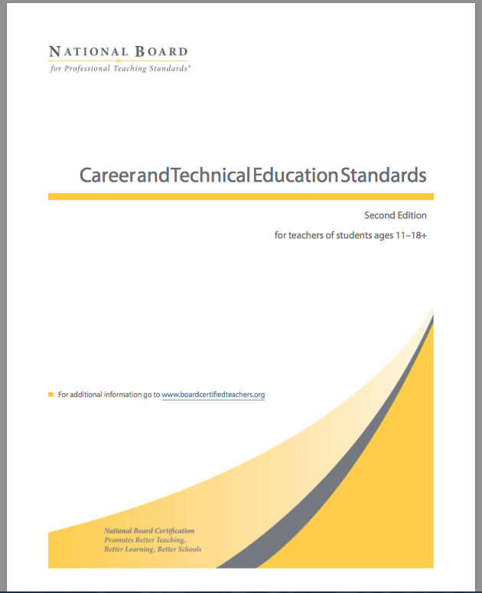
8-CTE Strands
Business, Marketing, and Financial Services
Community Services
Decorative Arts and Design
Engineering, Design, and Fabrication
Information Systems and Technology, Communications, and the Arts
Leisure and Recreation Services
Natural Resources
Transportation Systems and Services

Slide 8
The National Board Process
Component 1 (C1)
Content Knowledge
Component 2 (C2)
Differentiation in Instruction
Component 3 (C3)
Teaching Practice and Learning Environment
Component (C4)
Effective and Reflective Practitioner Released in November
Evidenced by:
Assessment Center
Evidenced by:
Student Work
and Portfolio
Evidenced by:
Video Recordings and Portfolio
Evidenced by:
Assessment materials and collaboration
Notes:
Time: 5 minutes
Trainer Notes: This is a VERY brief overview of the process.
Materials:
Tell Participants:
This is the required components of National Board Certification. A candidate will have up to three years to complete and submit all evidence for all four components of the National Board Process.
The Four components are:
Content Knowledge (Component 1): Evidenced by the assessment center
Differentiation in Instruction (Component 2) evidenced by student work and a written portfolio
Teaching Practice and Learning Environment (Component 3) evidenced by video recordings and written portfolio
Effective and Reflective Practitioner (Component 4) evidenced by generation and use of assessment data, evidence of how you meet your professional learning need, evidence of the student need and how you collaborated with others to meet that need and written commentary. This is currently in Pilot stage
Once all four parts of the National Board Process are “rolled out” and available, a candidate can choose to complete the process in three years, in two years or a candidate may complete the whole process in one year.
When choosing a certificate process (1, 2, or 3 years), consider how to best support continued accomplished teaching, school/professional responsibilities and family and social life.
National Board has made this process a little more manageable for candidates

Slide 9
2016-2017 Process at a Glance
Component 1: Content Knowledge
Component 2: Differentiation in Instruction
Component 3: Teaching Practice and Learning Environment
Component 4: Effective and Reflective Practitioner
Candidates may choose the process that is right for their personal and professional life: 1 year, 2 years or a 3 year process.
Must complete all 4 components within three years.
CTE directions for all components released November, 2016.
Notes:
Time: 3 minutes to present information + 5 minutes Q&A = 8 minutes total
Trainer Notes: Timelines explained below; note special conditions explained below for Career and Technical Education & World Languages Other Than English
Materials:
http://boardcertifiedteachers.org/sites/default/files/EAYA-CTE.pdf
http://boardcertifiedteachers.org/sites/default/files/EAYA_CTE_Component1.pdf
http://boardcertifiedteachers.org/sites/default/files/WL_Candidates_Prerequisite_FAQ.pdf
Tell Participants:
Regarding time frame for completion: You must attempt each of the four components within the first three years of your candidacy. There is no minimum or maximum score requirement to retake a component. However, once you achieve National Board Certification, retake attempts are no longer available. You have up to two retake attempts for each component and you can retake at any time during the five-year window; retake years do not have to be concurrent or consecutive. You can have a year when you take no components; however, it does not extend your five year window.
Candidates pursuing Career and Technical Education certification can currently review applicable standards found at http://boardcertifiedteachers.org/sites/default/files/EAYA-CTE.pdf. CTE candidates may register for C1 in 2016-17. An instructional booklet for C1 with sample CR & SR questions can be found at http://boardcertifiedteachers.org/sites/default/files/EAYA_CTE_Component1.pdf. Further, instructions & registration will be available for C2, C3 and C4 will be available to CTE candidates in the fall of 2016-17
New and important information: World Language Other Than English (WLOE): Component 1 will not be ready until 2016-2017. As of right now, the only two languages are Spanish and French. Refer WLOE candidates to the document: http://boardcertifiedteachers.org/sites/default/files/WL_Candidates_Prerequisite_FAQ.pdf Through 2016-2017, and perhaps beyond, the National Board has negotiated free and reduced expenses related to ACTFL assessment to demonstrate language proficiency, which are outlines in this document. Candidates will need to achieve ACTFL certification of Advanced Low or higher proficiency levels.
Final Thought: We are confident that ***YOU WILL BE ABLE TO MAKE CHOICES TO BALANCE taking more time to work on your certification will help keep a healthy balance of family, work and certification. At Jump Start, you will have the opportunity to delve into the component directions, requirements, and standards.

Slide 10
What is your National Board timeline?
Completing National Board Certification may take from one to five years
You must submit each of the four components within the first three years of your candidacy
You have up to two retake attempts for each component and you can retake at any time during the five-year window
How does this fit with your Washington state certification timeline?
Notes:
Time: 3 min
Trainer Notes:
Materials:
Tell Participants:
For more information, please see p. 5 of “Guide to National Board Certification” http://www.boardcertifiedteachers.org/first-time-candidates

Slide 11
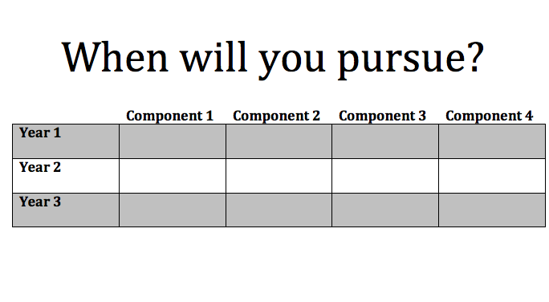
Individual Activity
X
X
X
X
Tips:
https://www.youtube.com/watch?v=jd3rdVyc38I
Notes:
Time: 5 min
Trainer Notes:
Materials:
Tell Participants:
Create a timeline for yourself. Will you complete the process in 1, 2 or in 3 years?
What are the reasons to pursue according to your timeline?
Turn and talk: Tell a neighbor when you will pursue each component and why

Slide 12
It’s your job to know your WA State Teaching Certificate Timeline!
National Board Certification is one way to obtain a Professional Certificate
ProTeach is another way to obtain a Professional Certificate
Teachers are responsible for maintaining their own certificate.
Find out more! OSPI certification office: cert@k12.wa.us
Notes:
Teachers are responsible for maintaining your own certificate. Ambassadors and facilitators often say, “I am not a certification expert and maintaining your certificate is completely up to you, the teacher.”
Pose the question, “What do you need to do now to determine your certification decision timeline?”
Have teachers contact the OSPI certification office for information about their certificate.
Ambassadors—you may choose to refer potential candidates to the ProTeach/National Board matrix handout at this point.
As potential candidates consider National Board certification, they need to get to know their teaching certificate timeline.
The Professional Educator Standards Board is in charge of all issues around teacher certification.
There was a PESB rule change at the March, 2014 meeting about residency certificate holders pursuing National Board Certification.
The change aligns National Board with Pro Teach reissuance criterion. The ruling now allows National Board candidates to sign an affidavit of intent for earning their certification. http://www.k12.wa.us/certification/nbpts/Renewal.aspx

Slide 13
Cost
4 Components
Cost
$2125 (3 years)
$2050 (2 years)
$1975 (1 year)
Payment
$475 per component
Pay per component as you go
$75 enrollment fee (each year)
Notes:
Affordability - The total cost of certification will decrease from $2565 to $1,975, with each of the four components costing $475. Candidates will have the option to pay for and submit components separately.
Two important price points
$475 for each component
$75 nonrefundable cycle enrollment fee (paid annually)
There will still be a conditional loan available from OSPI. The conditions for that are: a candidate must submit an application, a candidate must be participating in a cohort of support from an approved support provider and a candidate must agree to pay back the loan once they certify or choose to not pursue certification.

Slide 14
Advanced certification incentive in Washington State
$5151 annual bonus for the duration of the certificate
Additional annual bonus of up to $5000 in qualifying challenging schools
First year’s bonus prorated at 60%
Pensionable
Notes:
Qualifying Challenging Schools:
Elementary School: 70% Free and Reduced Lunch
Middle School: 60% Free and Reduced Lunch
High School: 50% Free and Reduced Lunch
Official list of qualifying schools available at https://www.k12.wa.us/certification/nbpts/TeacherBonus.aspx
The first year’s bonus is prorated at 60%, as NBCTs certify partway through the year.

Slide 15
Financial Support in Washington State: OSPI Conditional Loan
To qualify for an OSPI Conditional Loan, candidates must join an OSPI Approved Cohort.
Loan recipients receive $1425 toward the $1900 assessment fee. Recipients must pay $475 to NBPTS for their first component, as well as $75 annual enrollment fee.
Conditional Loan Information
Notes:
OSPI Conditional Loan Application: http://www.k12.wa.us/Certification/nbpts/Candidacy/Loans.aspx
OSPI list of approved National Board Cohort Support Groups:
http://www.k12.wa.us/Certification/nbpts/Candidacy/Support.aspx
Look at this list of cohort groups before the presentation to determine what support is available to candidates in your area.

Slide 16
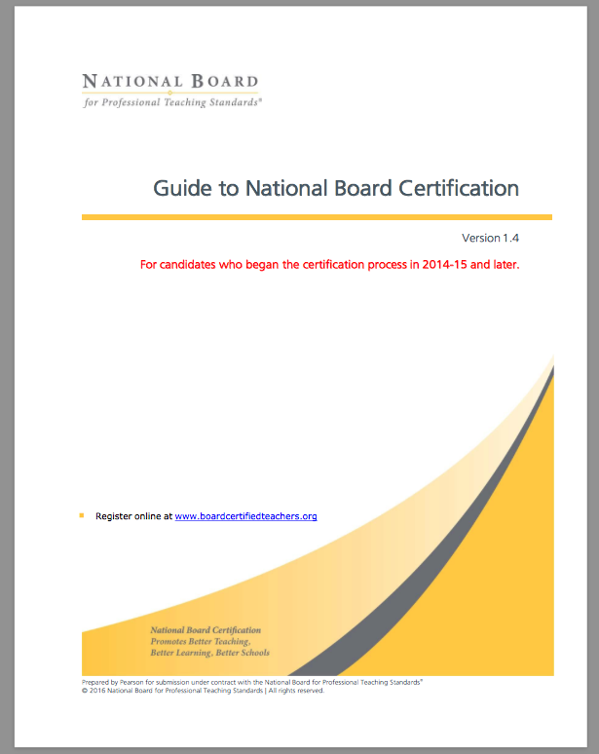
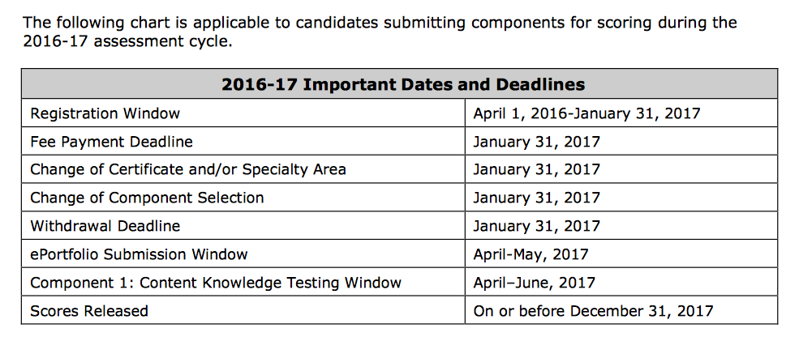
Notes:
Time: 5 min
Trainer Notes:
Materials:
Tell Participants: please open to your Guide to National board certification. This table can be found on page the bottom of page 4. Read through these dates. Tab this chart… you’ll use it on the mapping graphic organizer in a few minutes.

Slide 17
Ready to Pursue?
Go to Boardcertifiedteachers.org
Register as a National Board Candidate
Join a local cohort for support
Each student deserves access to accomplished teachers.

Slide 18
Resources
Heather Bulfinch, Davis High School, Yakima
Bulfinch.heather@yakimaschools.org
Nicole Mills Davis High School, Yakima
Mills.nicole@yakimaschools.org
Cindy Rockholt, Supporting Effective Educator Development (SEED) Grant Program Coordinator
cindyr@cstp-wa.org
http://www.nbpts.org/
http://boardcertifiedteachers.org/
https://www.washingtonea.org/pd/my-certification/jump-start-information/
http://www.k12.wa.us/Certification/nbpts/Candidacy/ForCandidates.aspx

